Slide 1

Operational Management
To Maximize Student Participation
Notes:
TELL

Slide 2
Overview
  This training will provide Food Service Managers (FSM) tools to effectively manage the operation while building student participation in our meal programs.
  Customer types and how to establish buy-in
  An effective approach called DPIE
      Diagnose, Prescribe, Implement, Evaluate
  Factors affecting participation
  Regional Profit and Loss report
  Identify cost per meal goals
  Calculate the cafeteria profitability percentage
  Controlling costs in the cafeteria
Notes:
TELL:

Slide 3
Objective
  Café LA strives to increase participation by providing nutritious meals to students that include choices based on customer preferences.
  This customer focused service:
  Creates a positive environment that maximizes participation to sustain the operation
  Utilizes strategies and tools provided to increase efficiency within the Food Services Division
Notes:
TELL: Food Services motivates students to select nutritious foods. As Cafe LA employees we help to facilitate this goal by employing research based principles that assure quality and help us continue with our commitment to nourish children to achieve excellence. This customer focused service helps to foster a positive environment that maximizes participation in your daily operation and utilizes strategies and tools provided to maximize efficiency within the Food Services Division.

Slide 4
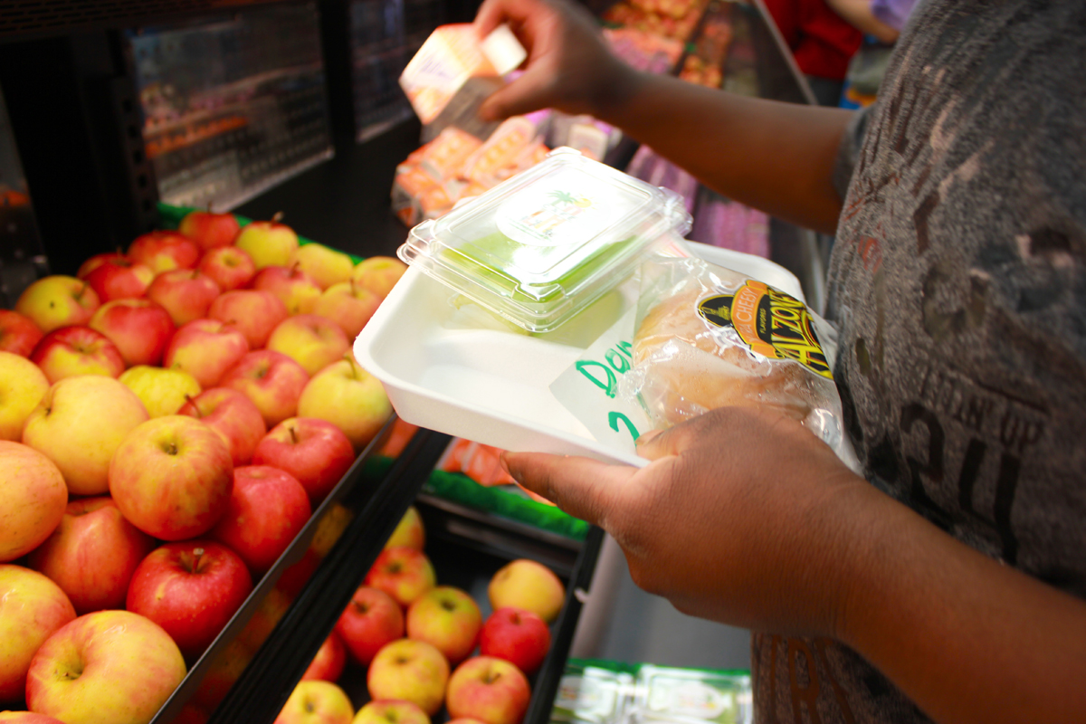
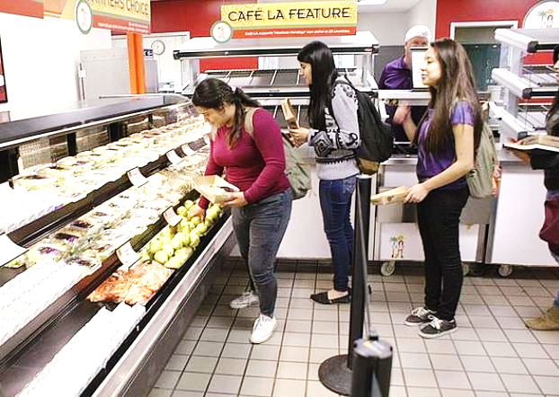
Know Your Customers
  Understanding your customers beliefs and perceptions will equip you with the tools to meet their wants and needs. This will build buy-in within your meal program.
  Buy-in takes place when customers agree to give support and accept ideas
Notes:
TELL: Any conversation regarding participation and building customer buy-in must begin by understanding who your customers are. Buy-in takes place when customers agree to give support and accept ideas. We will discuss 3 customer types that will focus on: the primary, external, and internal customers. The primary customer consists of our students. The external customers not to be confused with external students, are the faculty, parents, and administrators. This does not mean they are less important than our primary customers, in fact, external customers heavily influence the decisions of primary customers. Last but not least, we have our internal customers, who are the driving force behind the movement towards everyone having a “Café LA Day”. Let’s begin by taking a closer look at the primary customer on the next slide.
Click next slide

Slide 5
Get Your Staff Involved
Recognize the contributions of staff and use customer feedback to build a thriving meal program.
Empower your team to have a positive presence throughout your campus that promotes Café LA.
Encourage your team to assist customers in a way that makes the experience fun and enjoyable.
Notes:
TELL: To attain buy-in from your internal customers, highlight the importance of their interaction with customers and solicit feedback from customers that help to build a successful meal program. Another area that can have great influence is empowering your staff to have a presence within the campus that highlights the presence of Café LA. Use this presence to assist customers in a way that makes their Café LA experience fun and enjoyable.

Slide 6

“Marketing Nudge” to Create Buy-In
Nudging is the act of encouraging students towards participation in all of your offered Café LA meal programs.
Your participation goal is for every student to enjoy breakfast, lunch, and supper with Café LA 5 days a week!
Notes:
TELL: Sometimes, even these health conscious customers need a bit of encouragement towards healthier choices in the lunchroom. As a Food Service Manager it is your job to provide customers with a marketing nudge towards enhancing their experience and making them want to keep coming back. This is not a physical nudge. This “marketing nudge” can be achieved by simply paying attention to these 4 concepts. In order to create buy-in from our primary customers we should engage with them by answering all of their questions with a friendly attitude that invites them to our Café LA. Incorporate visuals to facilitate the selection process and enhance the experience by marketing our healthier choices. Focus on building a good rapport with student’s families, friends, and teachers because of their influence towards this customers eating behaviors.Most importantly, take pride in your café LA site, this will allow you to build a natural environment that is positive and enhances the customer experience. These marketing nudges will assist towards increasing participation.

Slide 7
“Marketing Nudge” to Create Buy-In
Exclamations like,
“Welcome to Café LA, Lisa” shows customers you are excited to see them, everybody likes it when you know their name!
Engage with students, parents and staff before and after school by being present in the schoolyard.
Marketing Nudges
Customer Engagement
Visual Aid Marketing
Influence
Café LA Pride
For visual appeal; consider placing fruits, vegetables, and white milk in multiple places on the service line.
Influence students toward healthy food choices by interacting with them during meal service.
Notes:
TELL: Sometimes, even these health conscious customers need a bit of encouragement towards healthier choices in the lunchroom. As a Food Service Manager it is your job to provide customers with a marketing nudge towards enhancing their experience and making them want to keep coming back. This is not a physical nudge. (animation 1)This “marketing nudge” can be achieved by simply paying attention to these 4 concepts. (animation 2) In order to create buy-in from our primary customers we should engage with them by answering all of their questions with a friendly attitude that invites them to our Café LA. (animation 3) Incorporate visuals to facilitate the selection process and enhance the experience by marketing our healthier choices (animation 4). Focus on building a good rapport with student’s families, friends, and teachers because of their influence towards this customers eating behaviors (animation 5).Most importantly, take pride in your café LA site, this will allow you to build a natural environment that is positive and enhances the customer experience. These marketing nudges will assist towards increasing participation.

Slide 8




DPIE to get Buy-In
D
When faced with issues that will effect your participation due to a lack of customer buy-in, use the DPIE approach to solve participation issues as they arise during any meal serving period.
P
I
E
Notes:
TELL: Inevitably, you will be faced with issues that will affect your participation. Use the DPIE approach to solve participation issues faced during any meal serving period. Yes it’s another acronym but this is simple and won’t take long, I promise. Begin by “Diagnosing” to determine what works and doesn’t work in regards to participation at your school site. Then prescribe recommendations to customize changes that can lead to increasing participation. Next implement easy changes and steps you can make to complement your meal program and lead to increase. Finally evaluate the process by measuring and analyzing how the changes made a difference. Enjoy D-PIE and utilize this resourceful tool to help maximize the participation in your cafeteria. In the coming slides we’ll review scenarios where DPIE can help improve participation and provide examples of completed DPIE issues.

Slide 9
The D-P-I-E Process For Problem Solving
D
Diagnose: Determine what is already working and what is not.
P
Prescribe: Recommend changes that could lead to increasing participation.
Implement: Make easy changes which complement your meal program and lead to an increase in participation.
I
Evaluate: Measure and analyze how the changes influence a difference in participation counts after implementation.
E
Notes:
TELL: Inevitably, you will be faced with issues that will affect your participation. Use the DPIE approach to solve participation issues faced during any meal serving period. Yes it’s another acronym but this is simple and won’t take long, I promise. Begin by “Diagnosing” to determine what works and doesn’t work in regards to participation at your school site. Then prescribe recommendations to customize changes that can lead to increasing participation. Next implement easy changes and steps you can make to complement your meal program and lead to increase. Finally evaluate the process by measuring and analyzing how the changes made a difference. Enjoy D-PIE and utilize this resourceful tool to help maximize the participation in your cafeteria. In the coming slides we’ll review scenarios where DPIE can help improve participation and provide examples of completed DPIE issues.

Slide 10
DPIE Case Study
DPIE can help increase participation by simply analyzing your situations and developing solutions.
There are several factors that affect student participation during BIC, such as:
  Classrooms not receiving enough meals
  Inaccurate claims made on the classroom roster
  Negative influence from classroom teacher
Notes:
Tell: Beginning with the first meal of the day, you may encounter issues from classrooms with low participation. This can include a high return rate of unpopular meal items, classrooms not receiving enough meals, an inaccurate or missing meal count roster, or even negative comments coming from the faculty or administration regarding your BIC program. DPIE can help to increase participation by analyzing the situation systematically and developing solutions.

Slide 11
DPIE Example - BIC
D
Diagnose: You notice rooms 43, 44, and 45 have very low participation numbers.
Prescribe: Work with principal to obtain approval to observe classroom service to identify factors effecting participation.
P
Implement: Add a personal touch and deliver breakfast to low participating classrooms and encourage students to eat breakfast.
I
E
Evaluate: Determine if an increase occurred after changes were implemented.
Notes:
TELL: As the manager at ABC elementary you start with diagnosing a situation where you notice 3 of your classrooms have very low participation numbers. By soliciting feedback from students and teachers you prescribe changes that allow you to develop a strategy to observe each classroom. Next, we implement a personal touch to those low participating classrooms by simply visiting the rooms and providing the students with a message about the benefits of eating at Café LA. Finally, we evaluate our process to determine if these small changes have led to an increase in your participation.

Slide 12
DPIE Activity
Identify the correct slice of DPIE in the following activity.
There are several factors that are affecting your student participation during cold supper:
  Student preference between shelf stable and fresh meals
  Unpopular menu items are offered
  Not reaching out to community
Notes:
TELL: Supper participation may be affected by student preferences of fresh food versus dry foods, the time that supper is distributed, and the introduction of new items that can intimidate students. In the next slides, we will practice identifying stages of DPIE by providing you with scenarios that are part of the D-P-I-E process and then review the results it can give us.

Slide 13



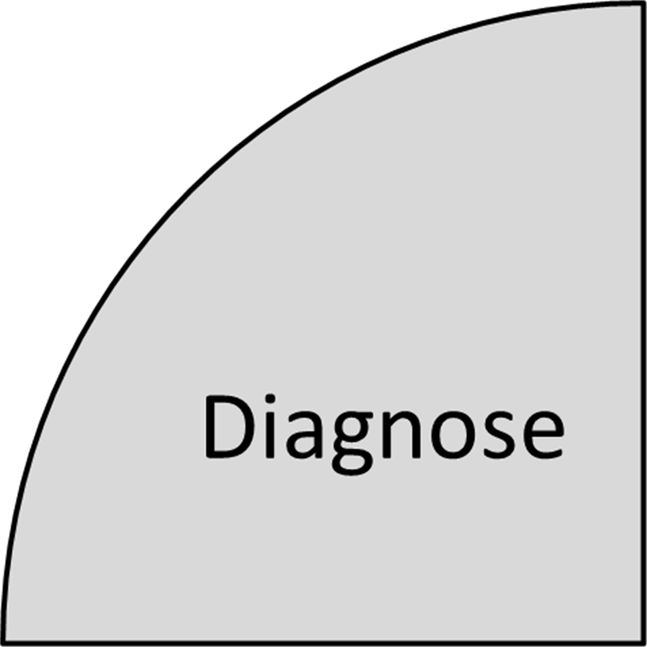
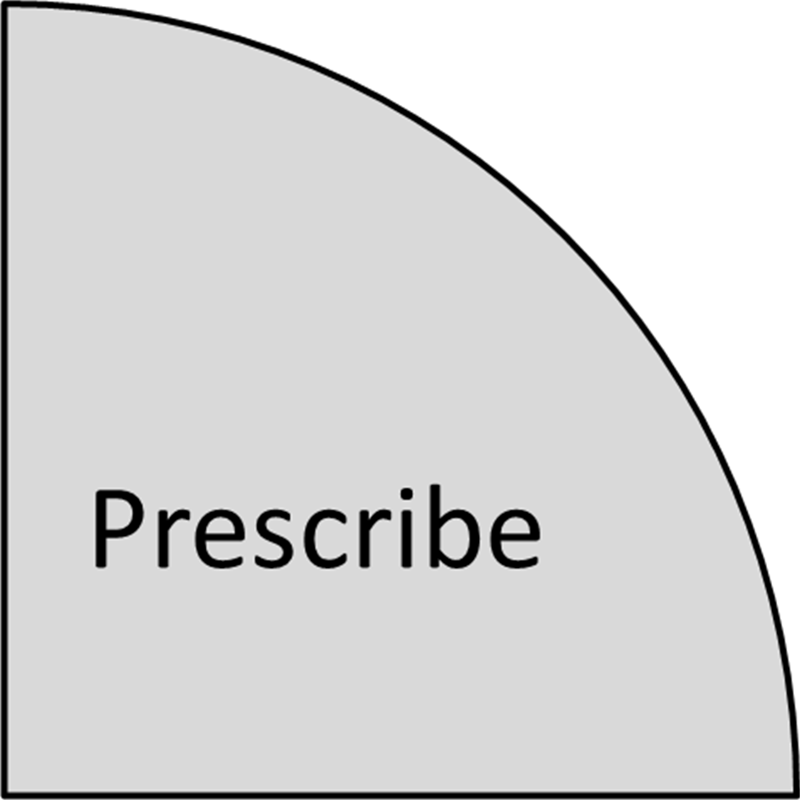
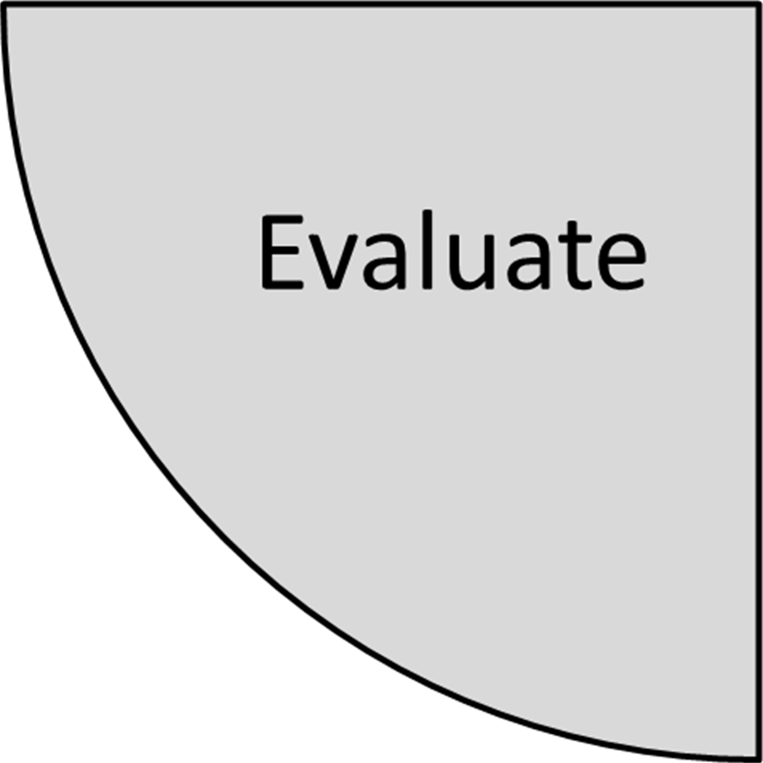
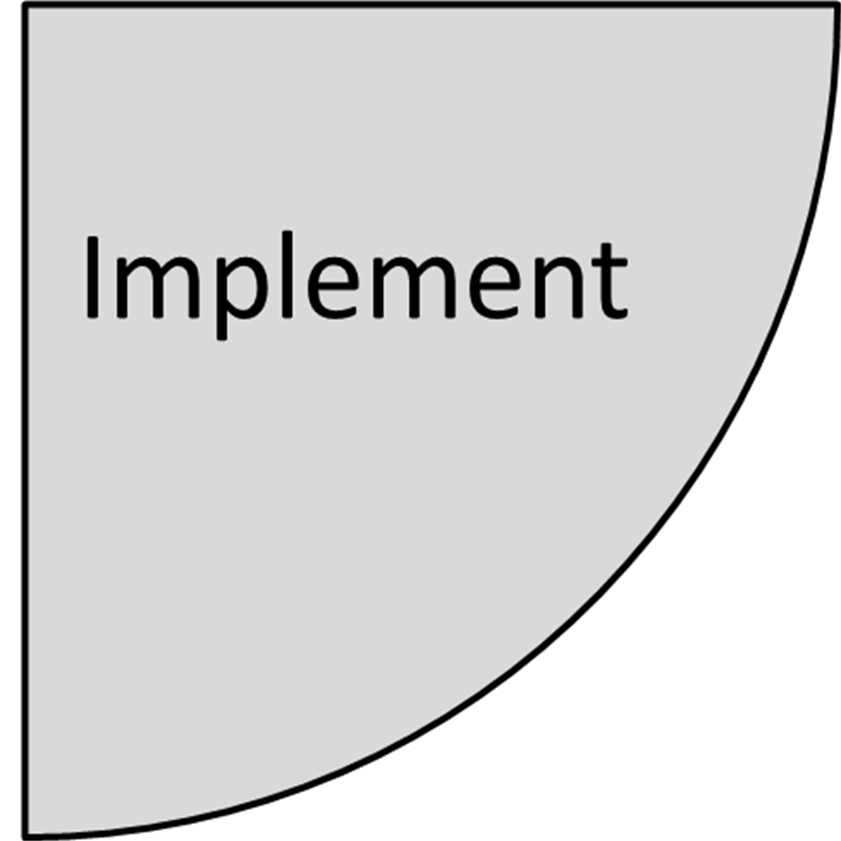
D-P-I-E In Action
You notice a major decline in student participation on Tuesday’s and Wednesday’s.
What slice of D-P-I-E is this?
Diagnose
Notes:
Tell: You noticed that on Tuesday’s and Wednesday’s there is a major decline in student participation.
What slice of D-P-I-E is this?
Click on the correct slice of D-P-I-E to continue

Slide 14
D-P-I-E In Action
You realize on Tuesday and Wednesday you are serving the shelf-stable meals and switch to serving fresh supper meals.
What slice of D-P-I-E is this?
Implement
Notes:
Tell: You realize on Tuesday and Wednesday you are serving the shelf-stable Goldstar items so you change it to fresh supper items for the next order.
What slice of D-P-I-E is this?
Click on the correct slice of D-P-I-E to continue

Slide 15
D-P-I-E In Action
Review cold supper menu on low participation days to determine possible causes.
What slice of D-P-I-E is this?
Prescribe
Notes:
Tell: Review menu’s for the 2 days in question to determine difference.
What slice of D-P-I-E is this?
Click on the correct slice of D-P-I-E to continue

Slide 16
D-P-I-E In Action
Determine if an increase occurred after changes were implemented.
What slice of D-P-I-E is this?
Evaluate
Notes:
Tell: You realize your participation numbers increase the week that you serve Goldstar Fresh items on Tuesday and Wednesday.
What slice of D-P-I-E is this?
Click on the correct slice of D-P-I-E to continue

Slide 17
Increasing Participation
Use DPIE to develop strategies to increase participation for each serving period: breakfast, lunch, snack and supper.
Increasing participation is an obtainable goal when using DPIE.
Notes:
TELL: Moving forward, use DPIE to develop strategies to improve participation at your school site during any serving period. This tool takes on challenges by using a systematic approach to problem solving that allows you to obtain an increase in your cafeteria’s participation.

Slide 18









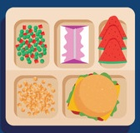







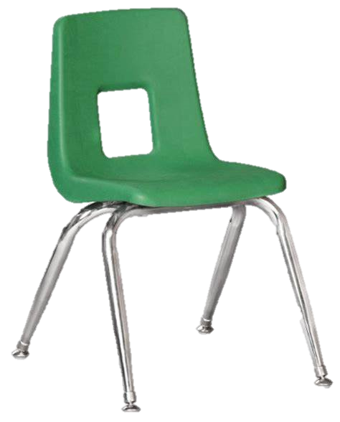
Participation Builder
Participation builders focus on:
Presentation
Ambience
Food variety
Customer service
Cleanliness
Value
A participation builder knows the wants and needs of their customers.
Notes:
TELL: If reimbursement is the life of our business then Participation and sales can operate like its heart, pumping in cash and ensuring that the business grows and thrives. That’s why a business savvy leader will understand the importance and logistics of sales and participation in relation to business in general and their business in particular. A participation builder knows the wants and needs of their customers. They offer the best, ambience, food variety, presentation, efficiency, consistency, and customer service.

Slide 19
The Café LA Brand
Developing the Café LA brand at your school site will increase participation. Brand development creates a feeling of trust between customers and Café LA where students look forward to having a Café LA meal.
The more you promote the brand, the more buy-in you gain.
Notes:
TELL: The development of the Café LA brand at your school site translates to an increase in participation. Brand development creates trust between customers and Café LA that all their needs will be met and they will have a great Café LA meal. The more you promote the brand, the more buy-in you gain.

Slide 20
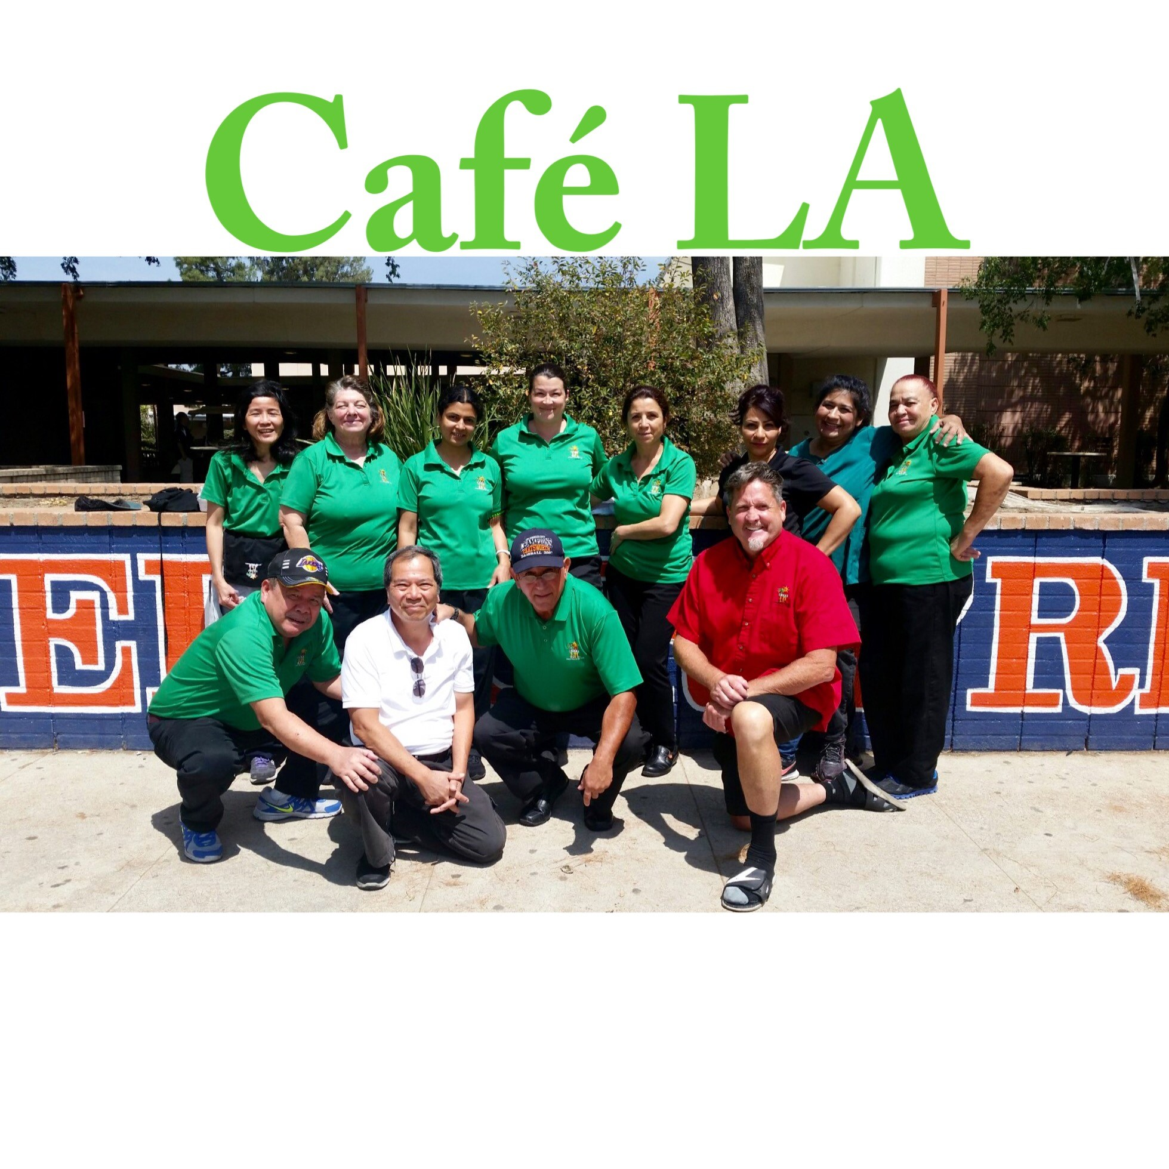
Customer Service
You and your staff are brand ambassadors for Café LA. Train and motivate your staff to promote a positive image of the cafeteria so that participation continues to increase.
Notes:
TELL: Are customers thinking about our brand outside of the four walls of the cafeteria? Mentally, we want customers to think about Café LA positively all throughout the day. As the messenger representing the brand, we must train and motivate our staff to project a positive image of our business. This will enable us to continuously reach potential buyers and create brand linked memories that students can remember when they are outside of the cafeteria.

Slide 21

Café LA Ambience
Ambience is the character and atmosphere of a place.
Applying changes to the physical appearance of your Café LA location will help your customers use their five senses to have a positive dining experience.
  Taste – our delicious food, of course!
  Smell – The aroma of tantalizing food!
  See – Posters and seasonal decor
  Hear – Music and laughter
  Touch - our delicious food, of course!
Notes:
TELL: Applying changes to the physical concepts of your cafeteria will deliver your Café LA focused message through tangible visual aids in a clean environment that incorporates colorful posters and signs, appropriate music and other effects, seasonal décor when necessary, and a consistent focus on cleanliness.

Slide 22
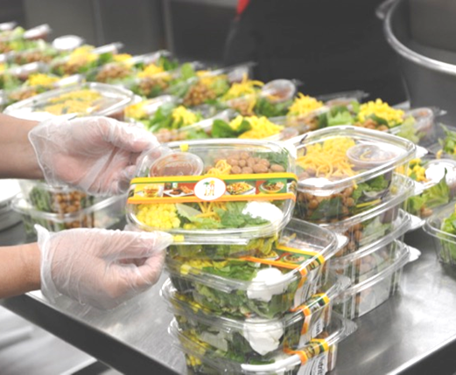

Taste The Food Quality
The Gold Standard
  Provides a visually appealing product
  All customers receive equal portions
  Consistent product from day to day
  Freshly prepared entrees and sides
  Hot food is hot
  Cold food is cold
Notes:
Tell: The Gold Standard is a proven technique that will allow you and your staff to deliver a standardized product customers will enjoy consistently, this really has an effect on increasing participation. What is the gold standard? The gold standard is the optimal sample plate from which other plates are to be modeled. It is important because the Gold Standard helps us to control cost in terms of food and labor, follow standardized recipes, and provide customers with a product they can enjoy in every aspect. The product meeting the gold standard will allow for consistency and will increase customer satisfaction which increases participation.

Slide 23
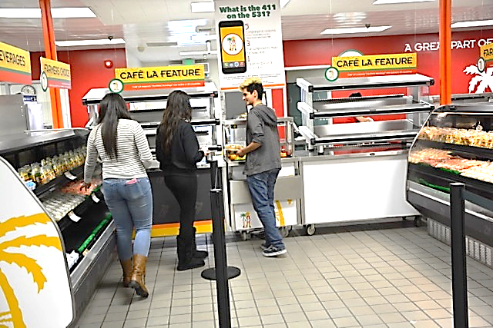
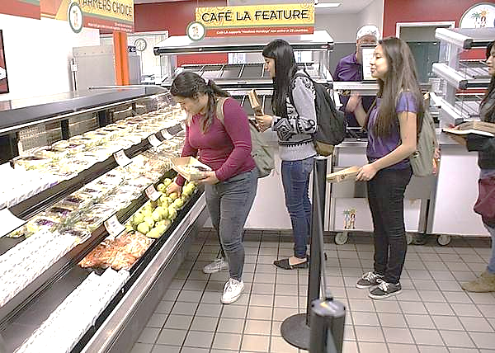
Smell The Cleanliness
Cleanliness was among the highest factors when it comes to affects on participation.
Remember to:
  Maintain a clean working and serving environment
  Communicate needs to the Plant Manager
  Promote cleanliness to students that you serve
Notes:
TELL: We all know just how important cleanliness is anytime we go out to eat, so it is important to uphold a high level of attention to this detail in regards to your meal programs. Breakfast, lunch, and supper are all representations of Café LA, so be sure to maintain a clean working and serving environment. You’ll also want to communicate any needs to the Plant Manager regularly and establish a good rapport so that your goal is clear. Finally promote cleanliness to the students that you serve everyday, so they can develop these good habits in and out of the cafeteria.

Slide 24
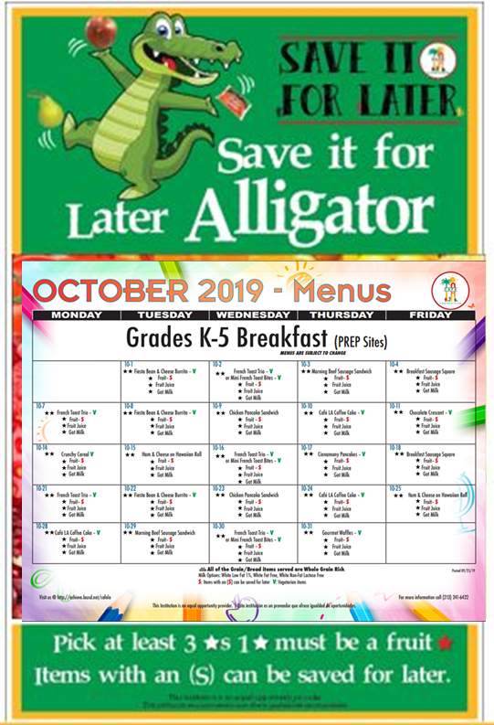
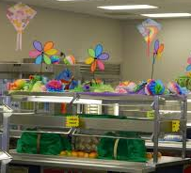
See Visually Appealing Decor
Signs and seasonal decor inform our customers and creates excitement.
Colors that trigger appetite such as red, orange, yellow, and green
1
Menu items with fun creative names
2
Educates students on reimbursable meal requirements
3
Notes:
TELL: Adding signage to your cafeteria is a great way of improving the look of your cafeteria. It’s something that students will remember because many times they look around as they wait in line for their food. This is an opportunity to catch their eyes with something that will be pleasing and create an appetite. Posters and signs also inform our customers on reimbursable meal requirements, menu items with fun creative names we are serving for the day and utilize colors that trigger appetite such as red, orange, yellow, and green.

Slide 25

Hear Music
Popular music helps to make your cafeteria seem more welcoming. Use appropriate music to:
  Grab customers attention
  Make wait times seem shorter
  Speed up the line
Notes:
Tell: Use popular music and seasonal décor to help make your cafeteria seem more welcoming and personable. Additionally, decorating your cafeteria tastefully and playing popular music helps to grab the attention of new customers while making the wait times in line seem shorter. In fact, studies have found that fast paced popular music increases the rate at which customers walk through your line.
Note: Music must be approved by the Principal and be age appropriate.

Slide 26
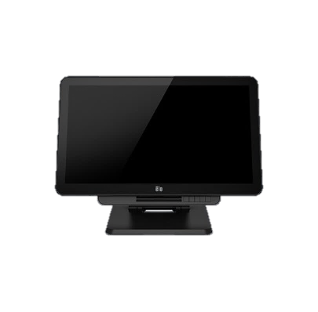
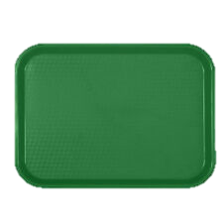

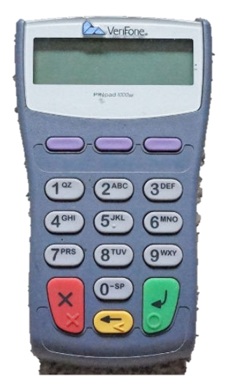


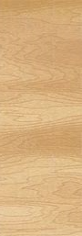
Touch And Build A Meal
Get them through the line quickly so they can touch their lunch. Long wait lines experienced during meal service can discourage customers from choosing to participate in your meal programs.
Small changes can speed up the efficiency of serving students.
Notes:
TELL: Building student participation will require on-going new ideas for the cafeteria. Some examples are: Rearrange the service line to better serve students. By making small changes like this one, you can speed up the efficiency of serving students.

Slide 27
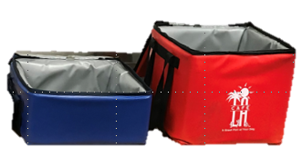
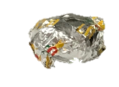

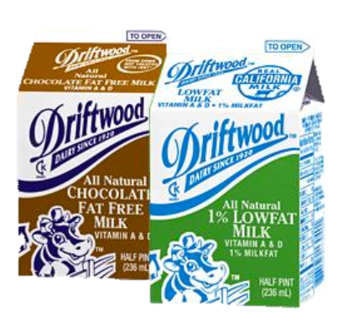
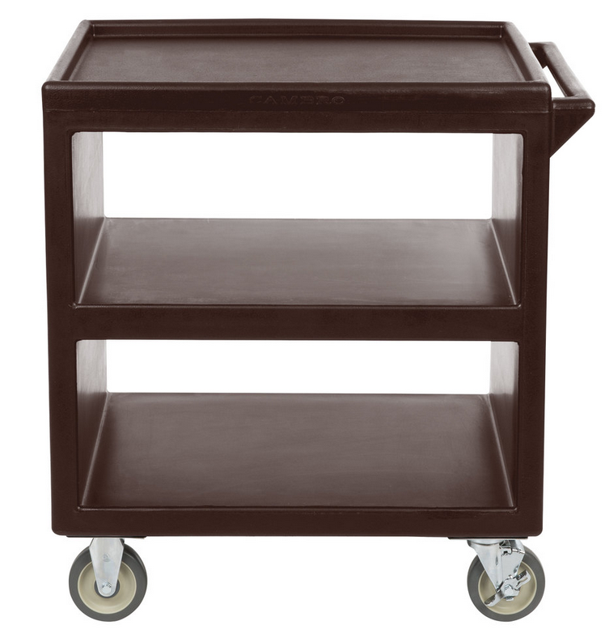
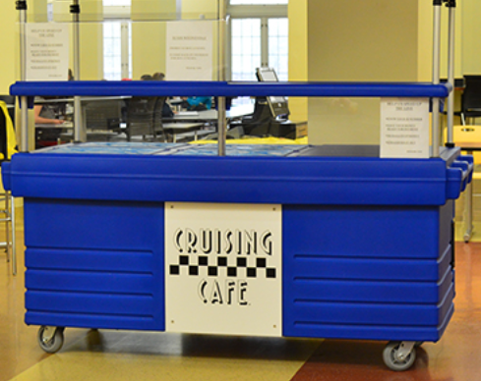
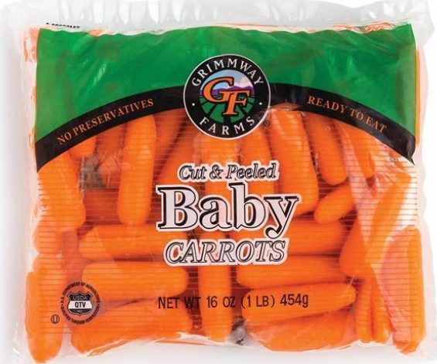
Solutions to Building Participation
Building participation takes “out of the box”, and “outside of the cafeteria” ideas.
DON’T HAVE A MOBILE CART?
Mobile Lunch Carts
To build participation, place a mobile cart away from the cafeteria to serve students who are not already eating with Café LA.
WHY NOT MAKE YOUR OWN?
Notes:
TELL: Building participation takes “outside of the box”, and “outside of the cafeteria” ideas. To build participation try placing a mobile cart away from the cafeteria to serve students who are not already eating with Café LA. Don’t have a mobile cart? Why not make your own? Food For thought, if you served 40 additional student per day using a mobile cart, how much revenue would the cafeteria receive? That’s right $22,896 based on free reimbursement of 40 meals per day times 180 operation school days. That’s a huge success. Finding participation solutions will contribute to the overall profit of a cafeteria and the Division.

Slide 28
Activity
By adding a cart to lunch service you feed 40 additional students per day. The reimbursement rate per meal is $3.18. How much additional revenue could your cafeteria receive in one year (180 school days)?
$46,428
$7,200
$22,896
$3.18 x 40 x 180 school days = $22,896
Finding participation solutions will contribute to the overall profit of a cafeteria and the Division.
Notes:
TELL: Building participation takes “outside of the box”, and “outside of the cafeteria” ideas. To build participation try placing a mobile cart away from the cafeteria to serve students who are not already eating with Café LA. Don’t have a mobile cart? Why not make your own? Food For thought, if you served 40 additional student per day using a mobile cart, how much revenue would the cafeteria receive? That’s right $22,896 based on free reimbursement of 40 meals per day times 180 operation school days. That’s a huge success. Finding participation solutions will contribute to the overall profit of a cafeteria and the Division.

Slide 29
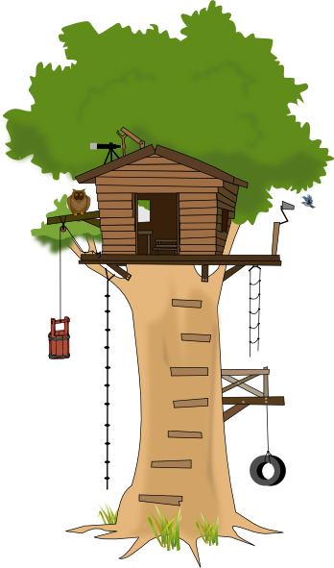



Treehouse Activity
SQUIRREL CAFE
Sally the Squirrel just opened Squirrel Café, she offers quality food at an affordable price but not all the animals seem to come to her treetop cafe.
Notes:
TELL: Sally the Squirrel just opened Squirrel Café, she offers quality food at an affordable price but not all the animals seem to come inside to eat.
INSTRUCTOR: Instruct the class to get it groups of 3 to 5 people. Hand out 1 flash card per group and instruct the groups to pick a leader to write downs ideas.

Slide 30





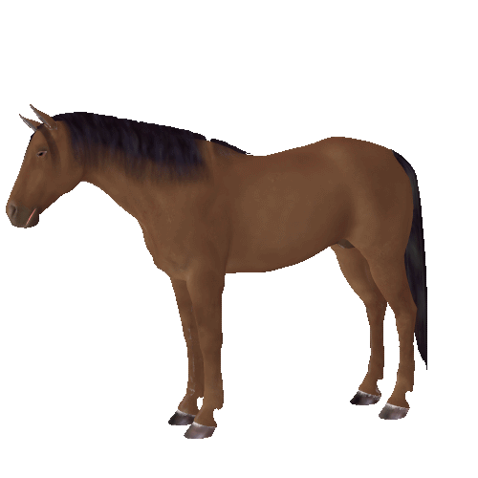







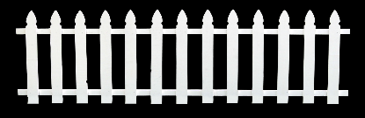















Open for Business!
SQUIRREL CAFE
What efforts could Sally make to increase her sales and feed all of the animals?
Notes:
TELL: Sally’s Squirrel Café is high up in a treehouse.
ASK: How can she feed all of the animals that are not able to make it to the café?
Action: Give the groups 5 minutes to discuss.
Action: Have each group share their ideas on how to feed all the animals.
ASK: How can this activity relate back to your cafeterias?

Slide 31
Every Meal Makes A Difference
Feeding 3 more students each meal period
(breakfast, lunch, and supper)
at all 682 school cafeterias provides
6138 more meals per day.
Generating an additional $3,266,643.60 annually
Notes:
Tell: Every meal makes a difference! Use the strategies and techniques of this presentation to attract more students to your Café LA. Feeding just 3 more students each meal period throughout our 682 school cafeterias would provide 2046 more meals to LAUSD students each day which means 368,280 more students will get a nutritional meal. Additionally, these 3 meals would generate $3,115,059.55 annually for the Food Services Division. You can make a difference with one meal, one student at a time.

Slide 32
Primary Source Of Revenue
Student participation provides the primary source of revenue for cafeteria operations. Federal reimbursement is provided for each qualifying reimbursable meal served to eligible students.
Meal Counts x Reimbursement Rates = Revenue
SBP and NSLP Reimbursement Rates
Type of Meal
Free
Reduced
Paid
Breakfast
2.04
1.74
.29
Lunch
3.18
2.78
.32
Notes:
TELL: One of the main revenue sources comes from the amount of participation your operation receives each day. Records of meals served can be found for daily viewing in the Meal Count Report within CMS. To calculate revenue, the food service uses the reimbursement rates, amount of money given by the federal government for each meal that meets program requirements to eligible students, and multiplies it by the meal counts. Let’s take a look at the Federal Reimbursements Rates the Food Services Division receives. For breakfast the FSD receives $2.04 for free, $1.74 for reduced price, and $0.29 for paid students.
For lunch FSD receives $3.18 for free, $2.78 for reduced-price, and $0.32 for paid students. Remember, to calculate Revenue, simply multiply reimbursable meal counts and the Reimbursement Rate.
NEXT SLIDE:

Slide 33







Accurate Meal Counts
  Food Services Division uses meal counts from CMS to claim Federal and State funds that support our operation.
  Managers are responsible to ensure all meal counts are entered in CMS at the POS and/or Daily Entry
  Central office uses counts entered in CMS for reimbursement
Notes:
TELL:
Generate a discussion with participants.
Describe what operational excellence is. Know the topic, quote books, motivational speakers, etc.
Ask questions of why they think it is important.

Slide 34






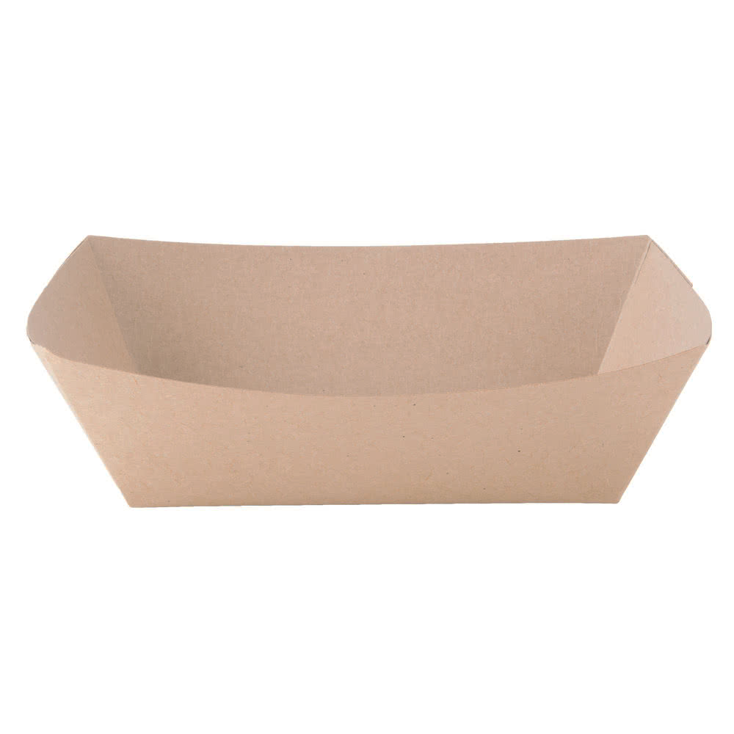


Meal counts are submitted to State and Federal government for reimbursement.
Lets follow the process for FSD to receive funds for reimbursable meals.
State and Federal funds are received.
Students receive reimbursable meals.
Meals are entered in CMS.
Notes:
TELL: It is important to input meal counts into CMS daily in order to make a timely reimbursement claim.
(Click and read each step)

Slide 35

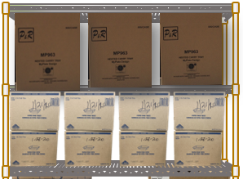
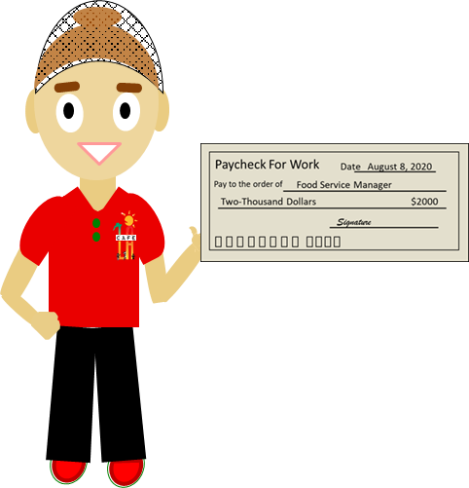


State and Federal funds received are used to pay for:
Food
Supplies
Labor
Benefits
Benefits
Notes:
TELL: Here is the process if a site fails to input their meal counts in CMS.
(Click and read each step)

Slide 36
Meal counts are NOT submitted for reimbursement.
What happens when meals are not properly claimed?
Manager does NOT enter meal counts in CMS.
Meal counts that are not entered into CMS contribute to the loss of revenue from State and Federal funds.
Students receive reimbursable meals.
Notes:
TELL: Here is the process if a site fails to input their meal counts in CMS.
(Click and read each step)

Slide 37
Business Skills
  Managing a Café LA operation requires business savvy skills that will allow mangers to measure the results. Determine if the cafeteria participation building activities are successful by using the following tools:
  Regional Profit and Loss Report
  Cost per meal goals
  Cafeteria profitability percentage
  Cafeteria budget
Notes:
TELL:
Generate a discussion with participants.
Describe what operational excellence is. Know the topic, quote books, motivational speakers, etc.
Ask questions of why they think it is important.

Slide 38
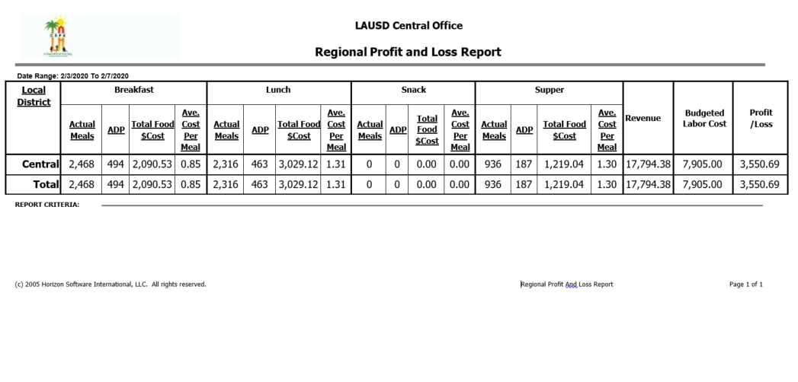
Regional Profit And Loss Report
  Managers can understand the cafeteria’s financial status by reviewing the Regional Profit and Loss report found in CMS. This report focuses on three areas.
Average Cost Per Meal
Revenue
Profit/Loss
Notes:
TELL:
Generate a discussion with participants.
Describe what operational excellence is. Know the topic, quote books, motivational speakers, etc.
Ask questions of why they think it is important.

Slide 39


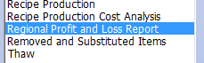



Accessing Regional Profit And Loss Report
Follow these steps in CMS to access the Regional Profit & Loss report.
Step 1
Step 2
Step 3
Step 4
Step 6
Step 5
Step 7
Notes:
TELL:
Generate a discussion with participants.
Describe what operational excellence is. Know the topic, quote books, motivational speakers, etc.
Ask questions of why they think it is important.

Slide 40
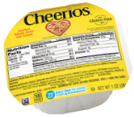
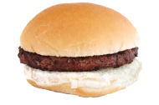
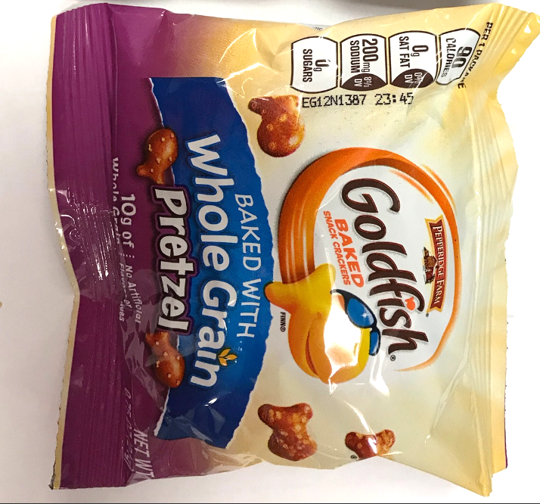
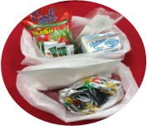
Average Cost Per Meal Column
Use the average cost per meal information to determine if the costs align with Division goals.
Compare the “Average Cost Per Meal” column on the Regional P & L Report to these target goals.
2020-2021 Target Meal Cost
BREAKFAST
$0.85
LUNCH
$1.35
SNACK
$0.45
HOT SUPPER COLD SUPPER
$1.35 $1.86
Target meal goals may vary due to COVID-19 unitized meals.
Notes:
TELL:
Generate a discussion with participants.
Describe what operational excellence is. Know the topic, quote books, motivational speakers, etc.
Ask questions of why they think it is important.

Slide 41
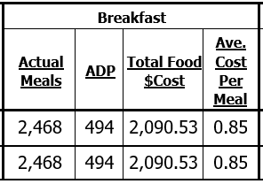

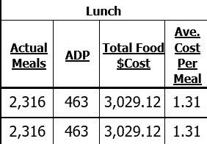

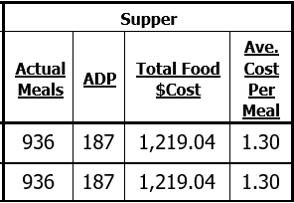

Activity
Is this school meeting the Cost Per Meal goals?
BREAKFAST
$0.85
Yes
LUNCH
$1.35
SNACK
$0.45
Yes
HOT SUPPER COLD SUPPER
$1.35 $1.86
Yes
Notes:
TELL:
Generate a discussion with participants.
Describe what operational excellence is. Know the topic, quote books, motivational speakers, etc.
Ask questions of why they think it is important.

Slide 42


Revenue and Profit and Loss Columns
The Revenue and Profit and Loss columns are used to calculate the cafeterias profitability.
We will focus on these two columns to determine if your individual cafeteria is making a profit.
Notes:
TELL:
Generate a discussion with participants.
Describe what operational excellence is. Know the topic, quote books, motivational speakers, etc.
Ask questions of why they think it is important.

Slide 43
Cafeteria Profitability Percentage
  The Cafeteria Profitability Percentage goal is:
  15% or greater
  To calculate the Cafeteria Profitability Percentage follow this formula:
Profit/Loss ÷ Revenue x 100 = Cafeteria Profitability Percentage
Notes:
TELL:
Generate a discussion with participants.
Describe what operational excellence is. Know the topic, quote books, motivational speakers, etc.
Ask questions of why they think it is important.

Slide 44
Calculating the Percentage
  Calculating the Cafeteria Profitability Percentage:
Profit/Loss ÷ Revenue x 100 = Profitability %
3550.69
÷
17794.38
x
100
=
19.95%
17,794.38
3550.69
Notes:
TELL:
Generate a discussion with participants.
Describe what operational excellence is. Know the topic, quote books, motivational speakers, etc.
Ask questions of why they think it is important.

Slide 45
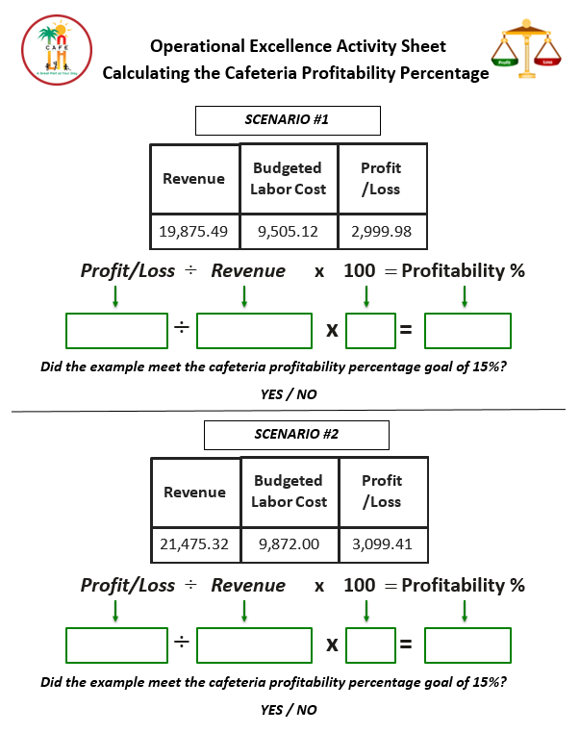
Activity Sheet
Use the Calculating the Cafeteria Profitability Percentage sheet for the following activities.
Notes:
TELL:
Generate a discussion with participants.
Describe what operational excellence is. Know the topic, quote books, motivational speakers, etc.
Ask questions of why they think it is important.

Slide 46
Activity #1
Use the Calculating the Cafeteria Profitability Percentage sheet for this activity.
YES! Café LA’s cafeteria profitability percentage goal is 15% or greater.
Revenue
Budgeted
Labor Cost
Profit
/Loss
Did this scenario meet the cafeteria profitability percentage goal?
19,875.49
9,505.12
2,999.98
19,875.49
9,505.12
2,999.98
19,875.49
2,999.98
Profit/Loss ÷ Revenue x 100 = Profitability %
2999.98
÷
19875.49
x
100
=
15.09%
Notes:
TELL:
Generate a discussion with participants.
Describe what operational excellence is. Know the topic, quote books, motivational speakers, etc.
Ask questions of why they think it is important.

Slide 47
Activity #2
Use the Calculating the Cafeteria Profitability Percentage sheet for this activity.
NO! This is lower than the cafeteria profitability percentage goal of 15%.
Revenue
Budgeted
Labor Cost
Profit
/Loss
Did this scenario meet the cafeteria profitability percentage goal?
21,475.32
9,872.00
3,099.41
21,475.32
9,872.00
3,099.41
21,475.32
3,099.41
Profit/Loss ÷ Revenue x 100 = Profitability %
3099.41
÷
21475.32
x
100
=
14.43%
Notes:
TELL:
Generate a discussion with participants.
Describe what operational excellence is. Know the topic, quote books, motivational speakers, etc.
Ask questions of why they think it is important.

Slide 48
Food Services Budget
  100% of the revenues received are budgeted to cover costs and government allowed reserves.
85%
10%
5%
85% is budgeted for food and labor costs.
Note: The cafeteria labor budget does not include wages paid to substitute workers.
10% is budgeted for “other costs” such as Central Office Staff labor cost.
5% is budgeted to “net cash resources”
School Nutrition Programs set aside funds that are equal to up to 3 months of operational cost.
Notes:
TELL:
Generate a discussion with participants.
Describe what operational excellence is. Know the topic, quote books, motivational speakers, etc.
Ask questions of why they think it is important.

Slide 49

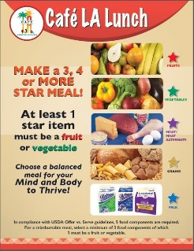



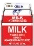


  When student participation decreases, so does revenue.
I don’t feel like eating today, let’s go play.
  The primary source of revenue in our cafeteria is from serving reimbursable meals to students.

Slide 50
Student Participation Goals
  When cafeteria operations fall below the student participation target goals a reduction in labor may be necessary.
  Meals per labor hour will be to low
  Will generate negative figures
  Too much labor compared to number of staff
  Labor optimization
Notes:
TELL:
Generate a discussion with participants.
Describe what operational excellence is. Know the topic, quote books, motivational speakers, etc.
Ask questions of why they think it is important.

Slide 51

Profit and Loss
  Analyze your cafeteria financial information daily to identify if you are meeting Division goals.
  15% or greater cafeteria profitability percentage
  Cost per meal targets align with Division goals
  Combined food and labor costs is below 85%
    Control food costs
Profit
Loss
Notes:
TELL:
Generate a discussion with participants.
Describe what operational excellence is. Know the topic, quote books, motivational speakers, etc.
Ask questions of why they think it is important.

Slide 52
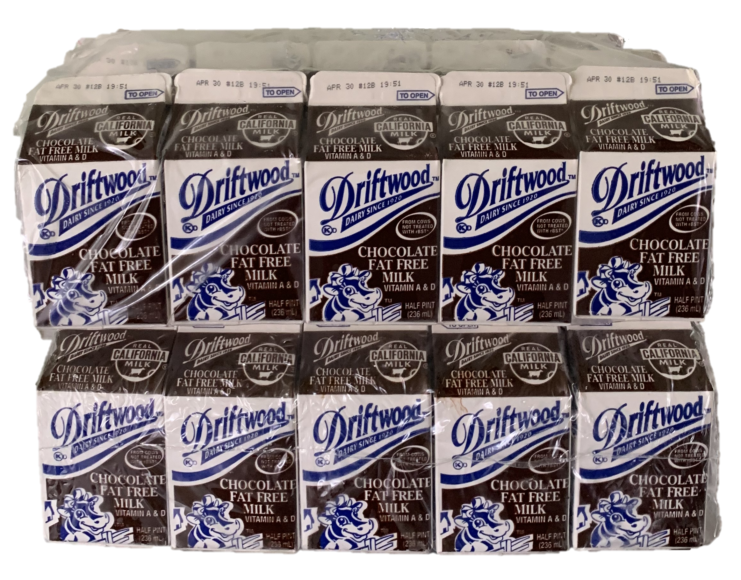

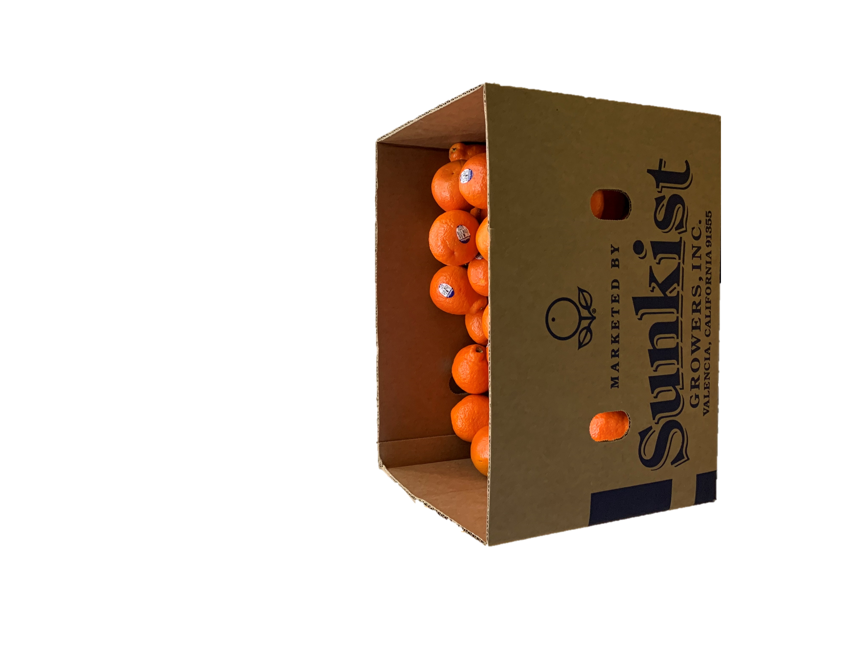

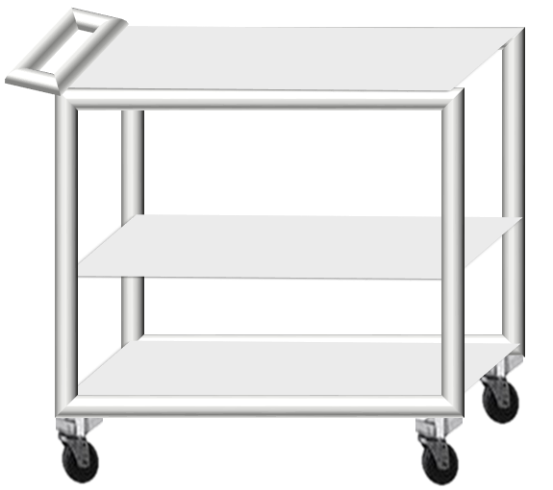

Food Cost
  Food cost is based on actual meals produced not on the number of meals served. Cafeteria food cost increases when:
  Over-production
  Dropped food
  Burnt items
Notes:
TELL:
Generate a discussion with participants.
Describe what operational excellence is. Know the topic, quote books, motivational speakers, etc.
Ask questions of why they think it is important.

Slide 53
Controlling Costs To Ensure A Profit
Financial performance will be affected if an operations cost are not controlled. Let’s review the following areas of controlling cost:
  Forecasting
  Ordering
  Portion control
  Reduce waste
Keep cost down
to ensure revenue turns into profit
Notes:
TELL: Financial performance will be affected if an operation’s cost are not controlled. Let’s review the following areas of controlling cost, there is operational costs, additional time, and reading reports such as profit and loss and dash board.

Slide 54
Controlling Food Cost - Forecasting
  Forecasting is a process of estimation in an unknown situation. FSM should consider the following to make realistic projections.
  Historical data: history will repeat itself
  Demographic factors: age group, gender
  Operational changes: New supper program, BIC
  Over a same time period: Tuesday minimum days
  Similar menus items: Teriyaki Chicken, Orange Chicken
  Weather forecasts: rainy day, hot days
  Outliers: special events, pep rallies, holidays
Notes:
TELL:

Slide 55
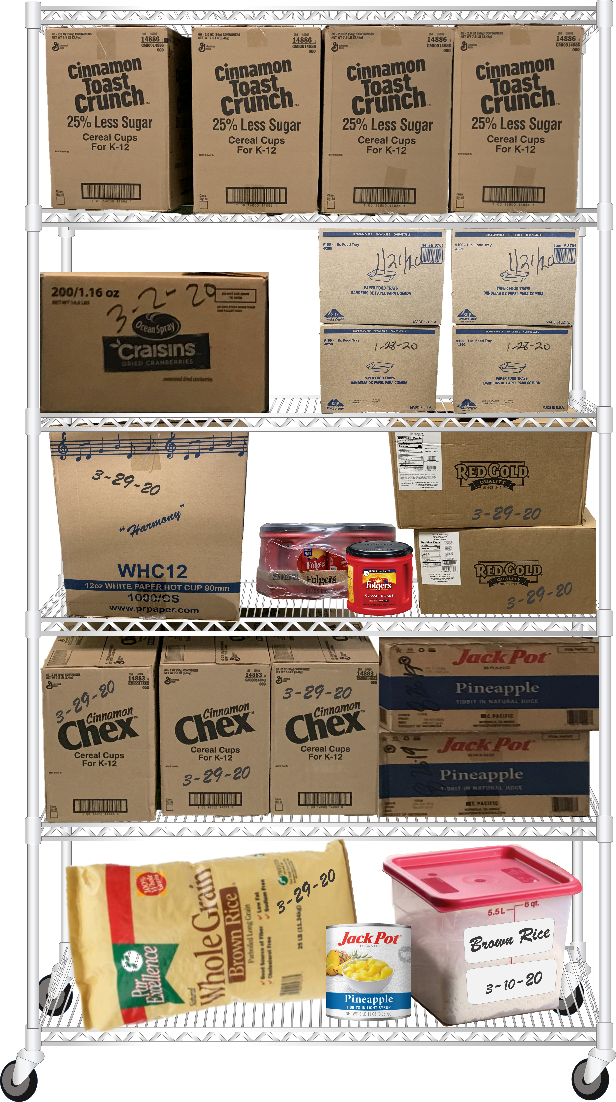
Controlling Food Cost - Ordering
  When ordering food and supplies use the following best practices:
  Physically check what you have on hand
  Revise and adjust shopping list order quantities
  Order based on customer preference
  Set realistic par levels
  Account for expected increased participation
Notes:
TELL:

Slide 56
Ordering And Inventory Management
  Costs accrued from inaccurate ordering and inventory management:
White Cleaning Cloths | Cost | Sporketts | Cost
1 case | $18.45 | 1 case | $12.90
2 cases on hand as back up $18.45 X 2 | $36.90 | 1 cases on hand as back up $12.90 X 1 | $12.90
300 sites with 2 cases on hand as back up $36.90 X 300 sites | $11,070 | 682 sites with 1 case on hand as back up $12.90 x 682 sites | $8,797
Total cost of non-moving inventory = $19,867
Notes:
TELL:

Slide 57
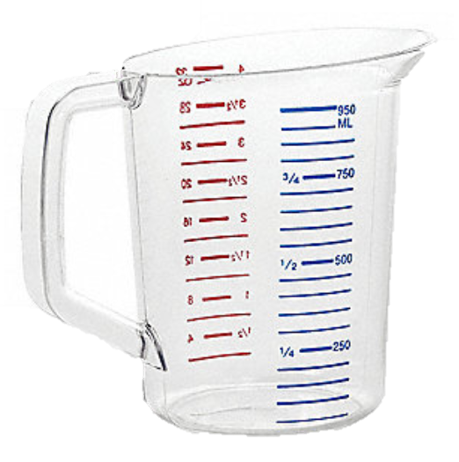
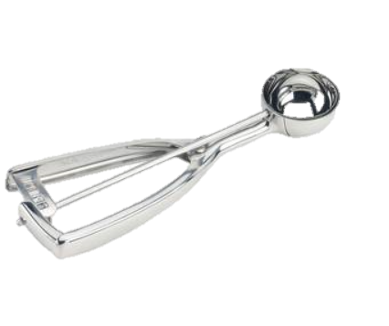
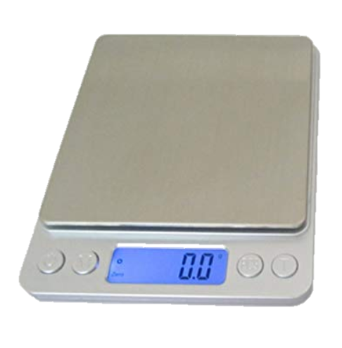
Controlling Food Cost – Portion Control
  Monitor staff periodically to ensure they use the correct portion sizes per standardized recipes:
  Identify disher size
  Measure correctly
  Proper use of scale
Notes:
TELL:

Slide 58
Importance of Adhering To Recipes
  Can one tomato slice affect the bottom line revenue, operating costs, expenses, and cafeteria profitability?
Cucumber and Tomato Salad | Cost | Lettuce Leaf and Tomato Slice | Cost
1 extra tomato slice on each salad | $0.03 | 1 extra tomato slice on each salad | $0.03
125 salads prepared $0.03 X 125 | $3.75 | 75 salads prepared $0.03 X 75 | $2.25
108 sites put 1 extra tomato slice on each salad for 10 days $36.90 X 375 X 10 | $4,050 | 108 sites put 1 extra tomato slice on each salad for 30 days $2.25 x 108 X 30 | $7,290
Total annual cost of not adhering to recipes = $11,340.00
Notes:
TELL:

Slide 59
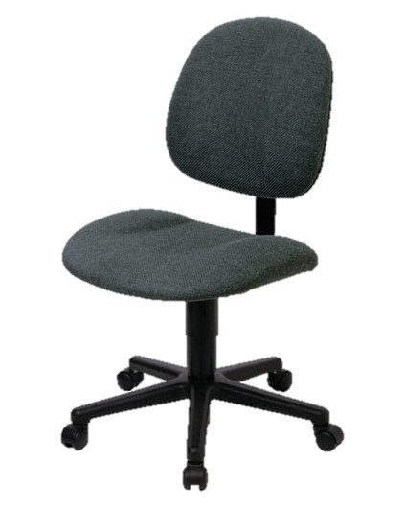




Controlling Food Cost – Reduce Waste
  To reduce waste review production history for all meal periods; BIC, Lunch, and Supper
  Do not over produce food items
  Follow Offer vs. Serve guidelines
  Adjust meal counts for field trips and minimum days
Notes:
TELL:

Slide 60
Cost of Excessive Waste
Breakfast Leftovers | Cost | Lunch Leftovers | Cost
1 Pancake 1 Cut Orange | $0.10 $0.09 | 1 Burrito 1 Apple Slices 1 Corn | $0.99 $0.24 $0.28
37 Pancakes leftover 37 X $0.10 37 Oranges leftover 37 X $0.09 | $3.70 $3.33 Total $7.03 | 22 Burritos leftover 22 X $0.99 29 Apples leftover 29 X $0.24 31 Corns leftover 31 X $0.28 | $21.78 $6.96 $8.68 Total $37.42
Breakfast leftovers at 550 sites 550 X $7.03 | $3,866.50 | Lunch leftovers at 550 sites 550 X $37.42 | $20,581
Total cost of discarded leftovers in a single day = $24,447.50
Annual cost: $24,447.50 X 180 days = $4,400,550.00
Notes:
TELL:

Slide 61

Result Of Increasing Participation
  Increasing participation grows your customer base and generates more revenue for the Food Services Division. Maximizing student participation will:
  Expand the reach of our meal programs to support the health and academic needs of students
  Reduce the encroachment on the General Fund
  Support ongoing employment opportunities within the Food Services Division
Notes:
TELL: Increasing participation is more than just a numbers game, participation grows the customer base and generates more revenue for the Food Services Division. Increasing participation requires the use of multiple strategies and suggestions to be successful. By increasing participation we can expand the reach of our meal programs to support the health and academic needs of students. Additionally, the increased revenue reduces our encroachment on the General Fund which supports the ongoing employment opportunities within the Food Services Division.

Slide 62
Thank You!
LAUSD Food Services Division
Nourishing Children to Achieve Excellence
Notes:
TELL: Questions?

